Slide 1
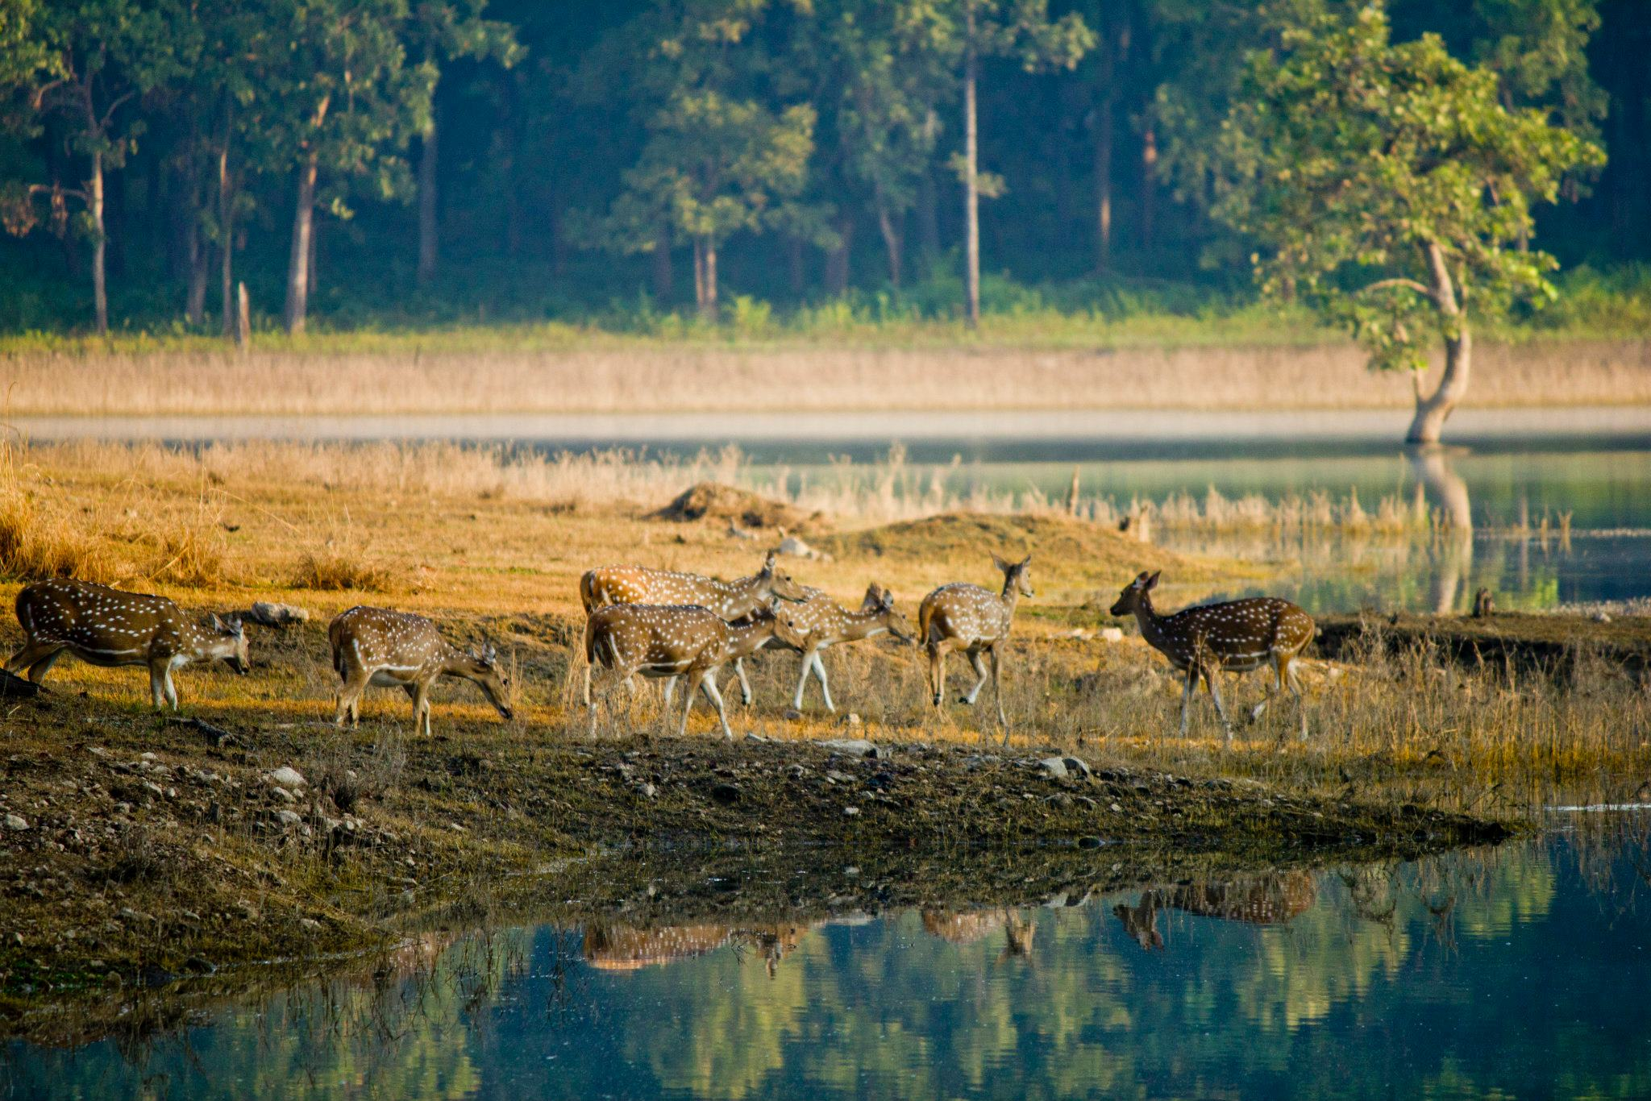
Land use and land cover change detection and decline in tiger population in central India.
Tania Banerjee
Advisor: Dr. Jun Luo
Department of Geography, Geology and Planning

Slide 2
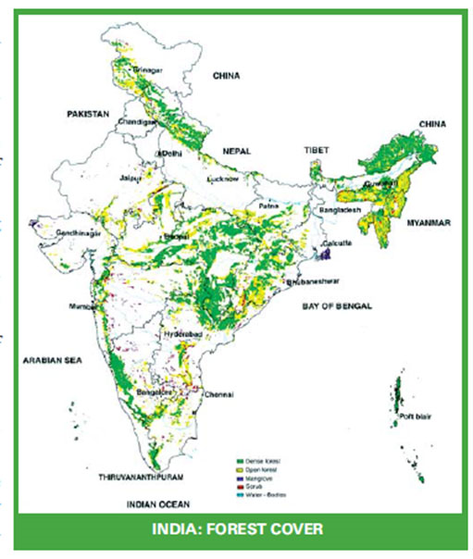
Background
After Green Revolution in 1970s, the deforestation continued for decades.
Since then, tiger was declared as an endangered species.
Human settlement near protected areas causes conversion of forests in agricultural land.
More agricultural land was in demand so as to feed the increasing population.

Slide 3
Research Objectives
To find the land use and land cover change since 2009 to 2016.
Find the change in forest over the years.
To find the relationship between the tiger mortality and deforestation.
Suggestion to policy maker and environmentalist

Slide 4
Why Tigers?
Tiger is the national animal of India.
Being endangered, tiger is the biggest concern for environmentalist.
Saving them is equivalent to saving ecosystem.(http://savetigersaveecosystem.weebly.com/why-save-tigers.html)
Tiger population declined from 100,000 in 1900s to 4000 in 1970s.(Tiger in Crisis, 2017)

Slide 5
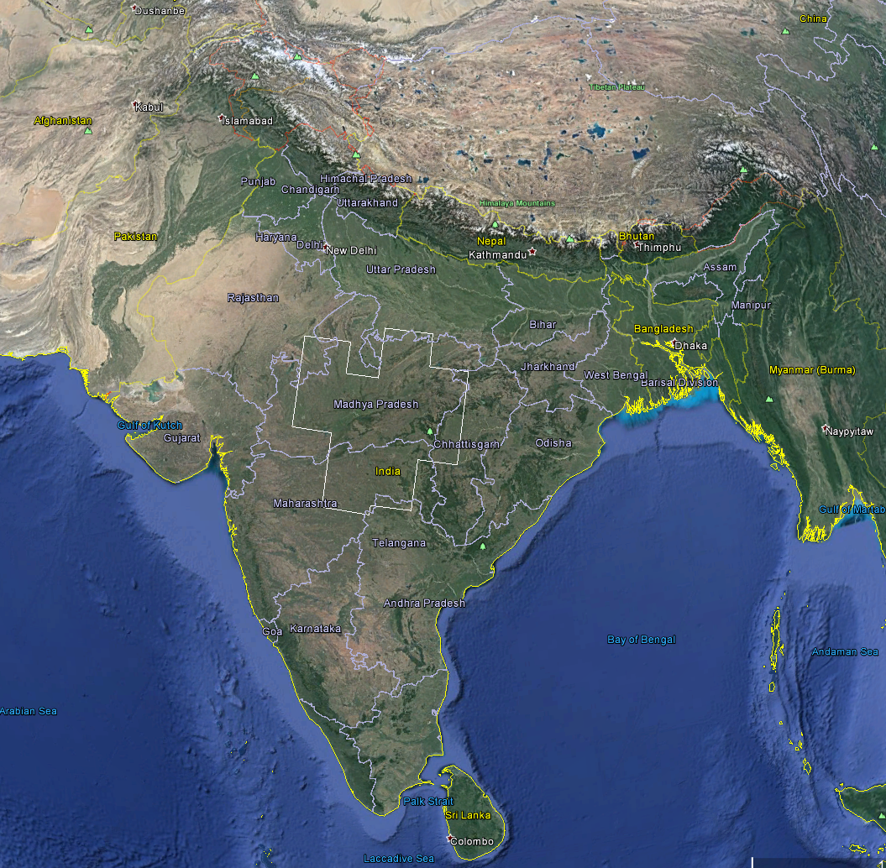
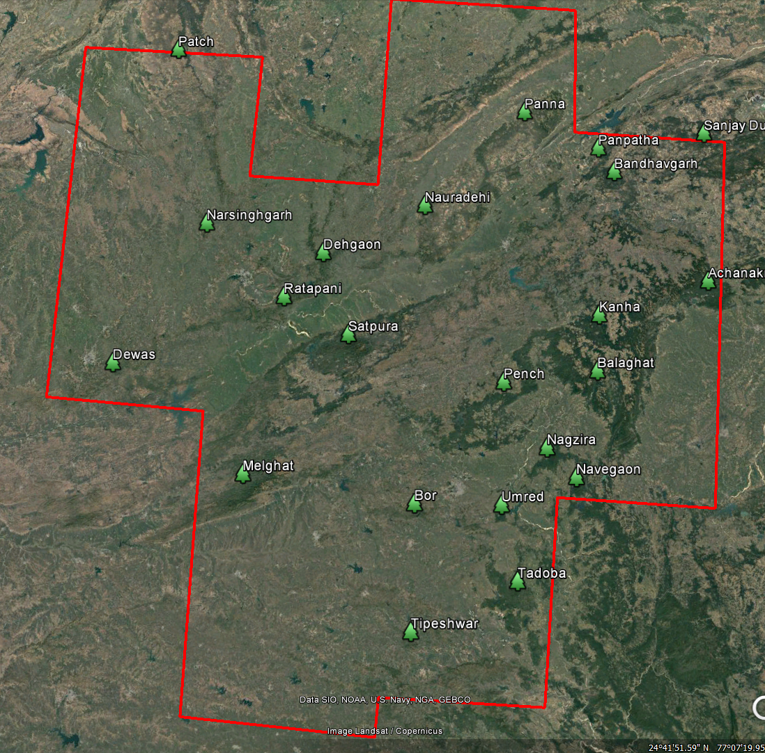
Study area
The study area is central India because of the highest number of tiger reserves.
Almost 19 protected areas for tigers.
Area:428K sq. km
Fig 2: The satellite image of central India.
Source: Google Earth Pro 7.1.5

Slide 6
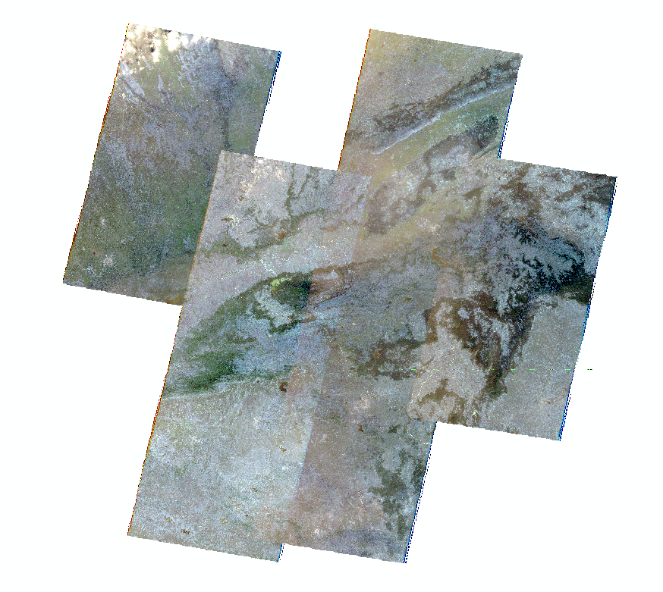
Study Area
Altitude: 284 m to 950 m above main sea level.
Located in states of Maharashtra, Madhya Pradesh and Chhattisgarh.
Majorly surrounded by big cities and high populated areas.

Slide 7
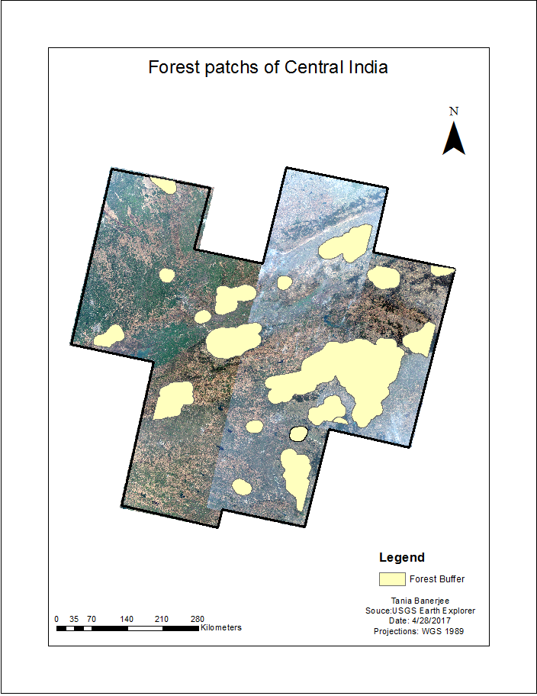
Forest patches

Slide 8
Data
Images
USGS Earth Explorer
http://earthexplorer.usgs.gov/
USGS Landsat
http://www.landsat.usgs.gov/
ArcGIS Image Server
Tiger mortality data
Wildlife Protection Society of India
http://www.wpsi-india.org
National Tiger Conservation Authority/ Project Tiger
http://projecttiger.nic.in/
Official database National Tiger Conservation Authority
http://www.tigernet.nic.in/
Open government data Platform (India)

Slide 9
Images Used | Year | Source
Landsat 5 ETM | 2009 | USGS Earth Explorer
ArcGIS image server | 2010 | ArcGIS Online
Landsat 5 ETM | 2011 | USGS Earth Explorer
ArcGIS image server | 2015 | ArcGIS Online
Landsat 8 | 2016 | USGS Earth Explorer

Slide 10
Methods
Landsat image classification:
Maximum supervised classification
Accuracy assessment
Tabulating areas of patches
Statistical methods : Spatially multivariate regression.

Slide 11
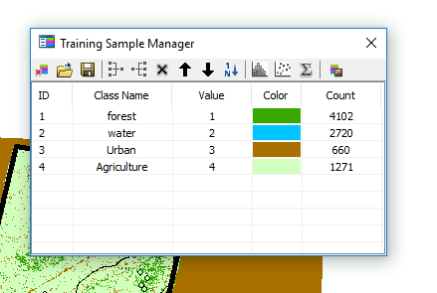
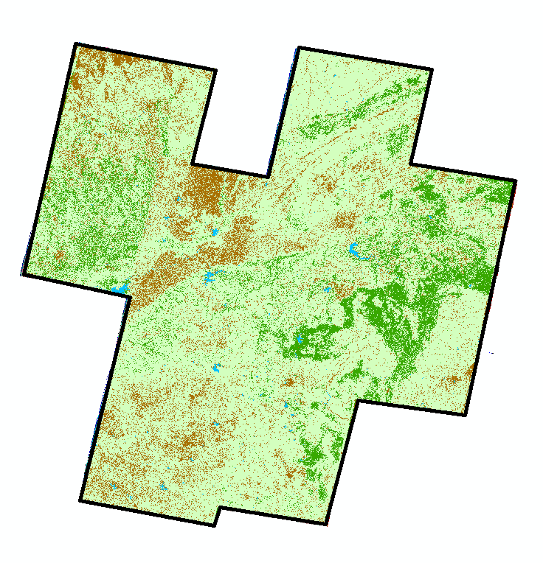
Supervised Classification methods
The user selects representative samples for each land cover class in the digital image called “training sites”.
These training set were used to categories pixels of similar reflectance values into units that were labeled after areas of identifiable features, such as forest, settlements, agricultural such on.

Slide 12
Accuracy Assessment
This methods is used to find the overall accuracy and Kappa value of the classification result.
It compares classified image to another data source that is considered to be accurate or ground truth data.
Select random points and creating confusion matrix.
In this case, the accuracy ranges from 64% to 86% which is good.

Slide 13
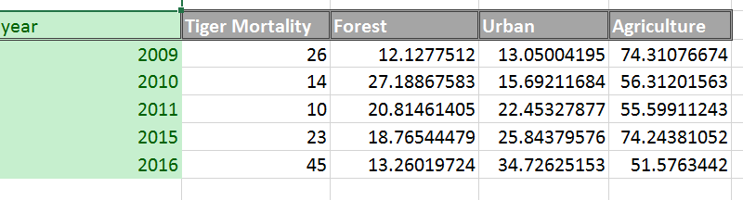
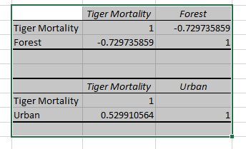
Forest Analysis

Slide 14
Graphs

Slide 15
Limitations and Constraints
In first half of the project, no proper shape files were found of the forests.
Landsat images do not have high resolutions.
Cloud coverage caused hindrances in classification
The tiger mortality data shows the number of tigers died in a patch instead of a particular point.
Therefore, the correlation is generalized.

Slide 16
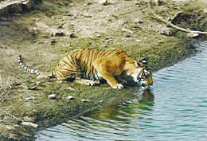
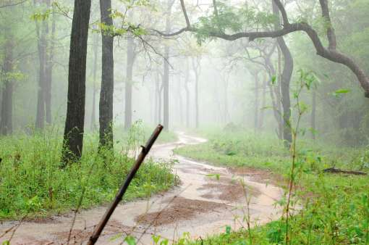
Conclusion and Discussion
Decline in forest from 27% to 13% of the total landcover.
Tiger mortality is indirectly proportional to forest.
Suggestion to policy maker and environmentalist.

Slide 17
References
Abdi, O. A., Glover, E. K., & Luukkanen, O. (2012). Causes and Impacts of land Degradation and Desertification: Case study of the Sudan. International Journal of Agriculture and Forestry, 3(2), 40-51.
Brink, A. B., & Eva, H. D. (2009). Monitoring 25 years of land cover change dynamics in Africa: A sample based remote sensing approach. Applied Geography, 29(4), 501-512.
Dinerstein E, Loucks C, Wikramanayake E, Ginsberg J, Sanderson E, Seidensticker J, Forrest J, Bryja G, Heydlauff A, Klenzendorf S, Leimgruber P, Mills J, O’Brien TJ, Shrestha M, Simons R, Songer M (2007) The fate of wild tigers. Bioscience 57:508–514. Doi: 10.​1641/​B570608
Challa, O., & Ramamurthy, V., Venugopalan, M.V. (2004). DYNAMICS OF LAND USE IN RELATION TO GREEN REVOLUTION IN INDIA. Land cover and land use, Encyclopedia of Life Support Systems. EOLSS-UNESCO Publ., Oxford.
Ellis, E. C., Kaplan, J. O., Fuller, D. Q., Vavrus, S., Goldewijk, K. K., & Verburg, P. H. (2013). Used planet: A global history. Proceedings of the National Academy of Sciences, 110(20), 7978-7985.
Katpatal, Y. B., Kute, A., & Satapathy, D. R. (2008). Surface-and air-temperature studies in relation to land use/land cover of Nagpur urban area using Landsat 5 TM data. Journal of Urban Planning and Development
Kwarteng, A. Y., & Al-Ajmi, D. (1997). Satellite remote sensing applications in the State of Kuwait. Kuwait Institute for Scientific Research.
Lambin, E. F., Geist, H. J., & Lepers, E. (2003). Dynamics of land-use and land cover change in tropical regions. Annual review of environment and resources, 28(1), 205-241.
Lambin, E. F., Turner, B. L., Geist, H. J., Agbola, S. B., Angelsen, A., Bruce, J. W., ... & Xu, J. (2001). The causes of land-use and land cover change: moving beyond the myths. Global environmental change, 11(4), 261-269.
Lambin, E., & Geist, H. (2007). Causes of land-use and land cover change. Retrieved from http://www.eoearth.org/view/article/150964
Pohl, C., & Van Genderen, J. L. (1998). Review article multisensor image fusion in remote sensing: concepts, methods and applications. International journal of remote sensing, 19(5), 823-854.

Slide 18

Thank you!!
Thank you!

